Slide 1
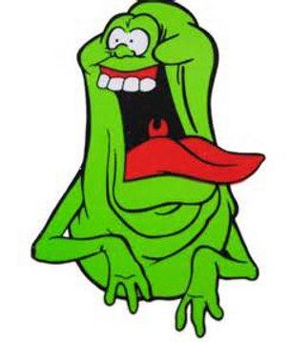
[We] ain't afraid of no [retrospective]

Slide 2
Retrospective Goals
Learning
Decide on an action
Strengthen our common bond
Look at the past to guide our choices for the future!
Notes:
Action: Hand each person an index card (< 5 minutes)
The overall goal of this exercise is to get people thinking in different ways about what are we doing that is great and what actions we can try to improve things that are not working.

Slide 3
Write your name on the front of the card
Divide the back of the card in half with a line and label one half “Successes” and the other half “Challenges”
Notes:
Action: Each person writes their name on the front of the card at the top. (1 minute)
On the back separate the card into two areas. Successes| Challenges

Slide 4
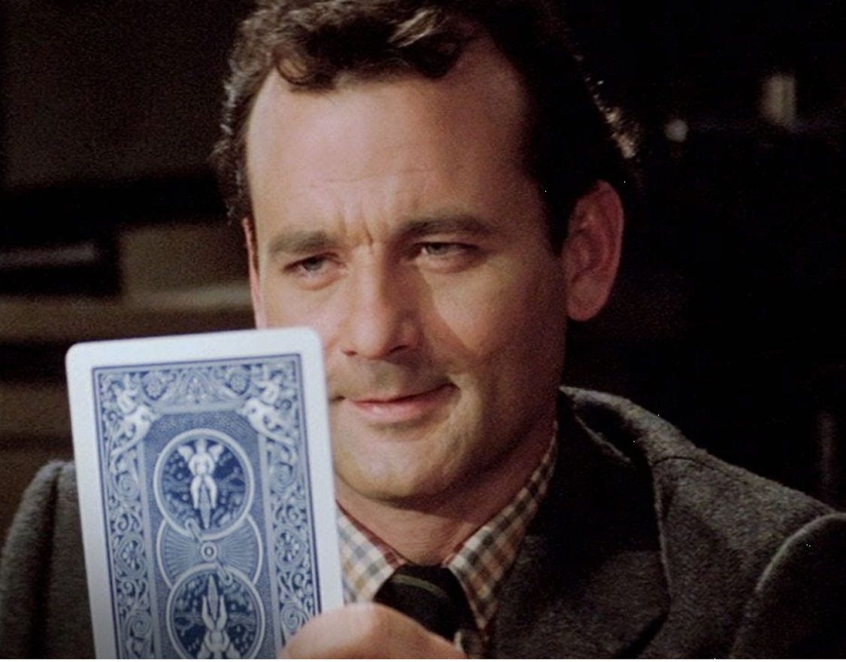
Notes:
Action: Describe and GO (11 minutes)
Everyone hands their card to the person to the left
Everyone writes what they think the person whose card they have would identify as successes or challenges.
Note: If you run out of room on the card - sticky notes can be attached to the back under Successes or Challenges.
After 1 to 1.5 minutes an announcement will be made and the cards will be handed to the next person on the left. Repeat until the cards have made it back to the owner.

Slide 5
Areas to Consider
What would an awesome situation look like?
What would have to be true to get there?
Notes:
Show this slide just to give people ideas of areas to think about when playing mind reader.

Slide 6
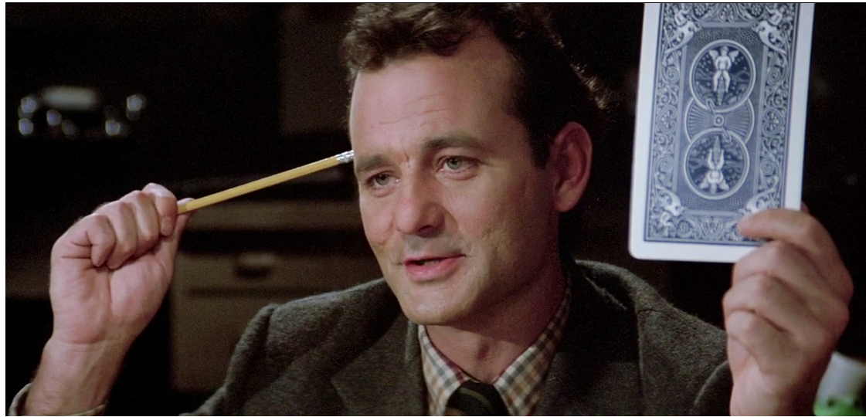
Notes:
Action: Describe and GO (5 minutes)
The owner should read the entries on the back of their card (silently) and group / summarize them on the front of the card. Then write what they found to be successes or challenges.

Slide 7
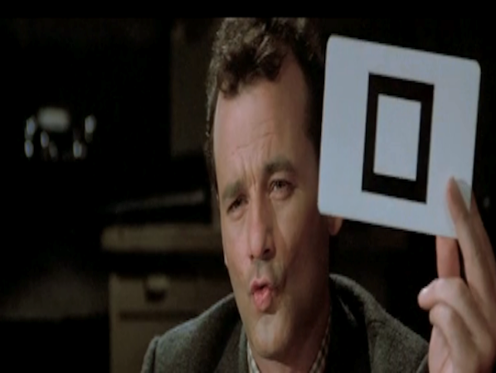
Notes:
Action: Describe and GO (11 minutes)
Go around the room and have each card owner give their summaries and thoughts based on what they put on the front of the card.
Allow 1 to 1.5 minutes per person

Slide 8
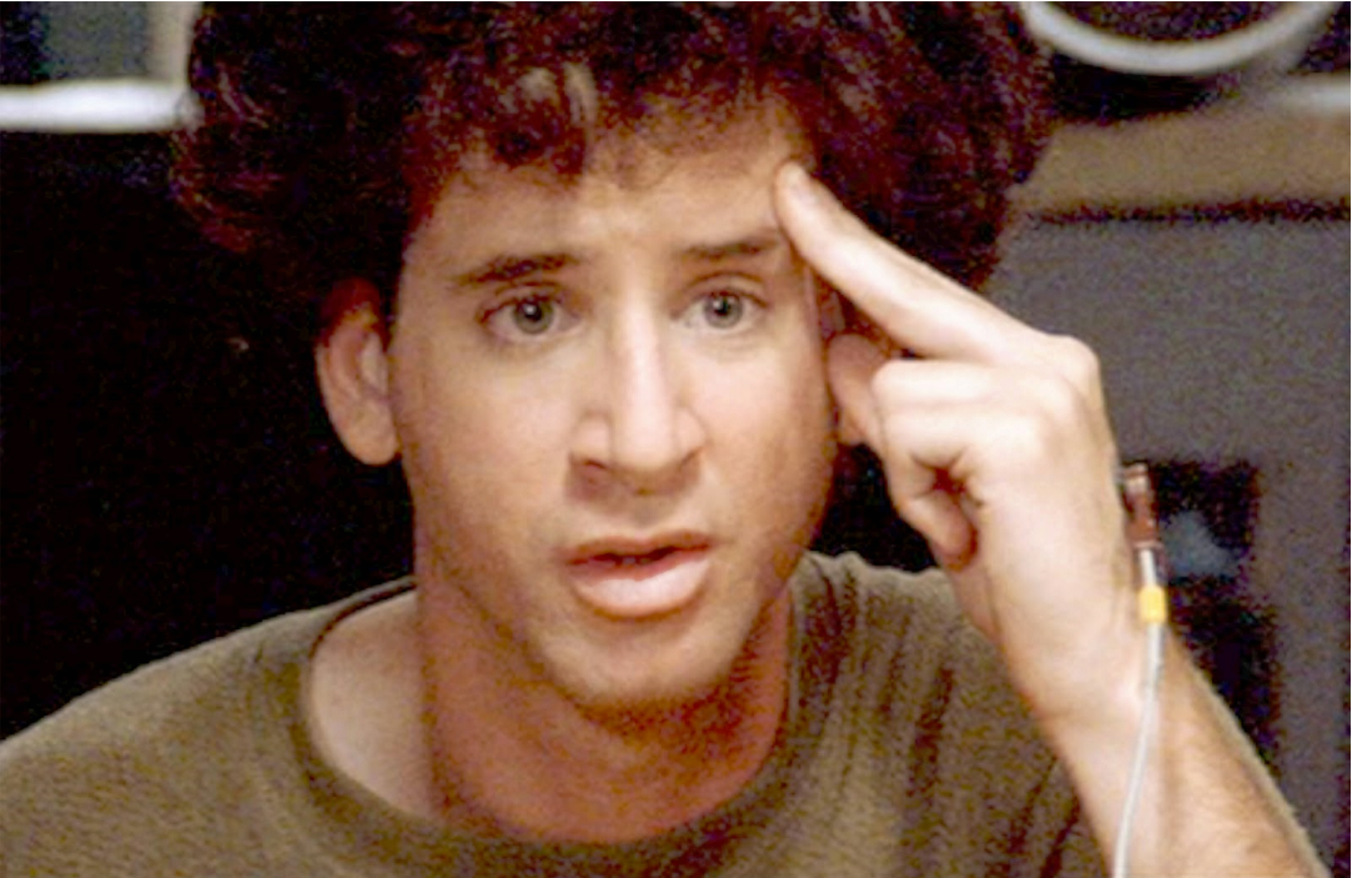
Problems
Solutions
Notes:
Action: Describe and GO (15 minutes)
The facilitator will then try to determine the most frequent challenge and ask group ways to improve the situation (if they could do anything)
Allow 15 minutes for this
Try to draw a consensus of a couple things to try.

Slide 9
Notes:
Action: Describe and GO (2-3 minutes)
The facilitator will then reinforce what people identified as the most frequent successes
Add to ToDo list to report back next week on change effectiveness.

